Slide 1
Joint Integrated protection system (JIPS): Systems engineering Plan (SEP) Update Internal program review (Ipr) 2
Team 1:
Chris Aall, Ryan Altenbaugh, Kimberly Battle, Steve Mazza, Liz Swisher, Maranatha Zopfi
5 Sept 2012

Slide 2
IPR 2 Agenda:
Program Summary: Review
Design Methods for External/Internal Interfaces
Test and Evaluation Strategies to Reduce Technical Risk
Design of Production and Support Systems
Low-Rate Initial Production (LRIP) Description
Production Levels vs. Deployment Schedule
Support Infrastructure vs. Deployment Schedule
Management of Obsolescence Issues
Training and Personnel Assignments to Support Manpower Requirements
Conclusion/Additional Concerns
2

Slide 3
Program Summary: Required Capabilities
The Joint Integrated Protection System (JIPS) shall protect permanent and semi-permanent bases in Southwest Asia from conventional and asymmetric ground attack.
The system shall integrate the Stronghold* sensor suite and C2 station, and a set of SWORDS* Unmanned Ground Vehicles (UGVs). (* Systems described in following slides)
The system shall be in full compliance with the connectivity and interoperability requirements of the Global Information Grid (GIG).
The system shall include all necessary support and maintenance documentation/procedures.
The system shall be ready for deployment in Southwest Asia by the end of 2018.
3
Notes:
As a review of IPR 1, the goal of the JIPS program is to protect permanent and semi-permanent bases in Southwest Asia from conventional and asymmetric ground attack.
Some additional top level required capabilities of the JIPS program are as follows: (see above)
This list does not contain ALL of the required capabilities, but summarizes those capabilities considered the most important and emphasized by program leaders and the end user community.

Slide 4
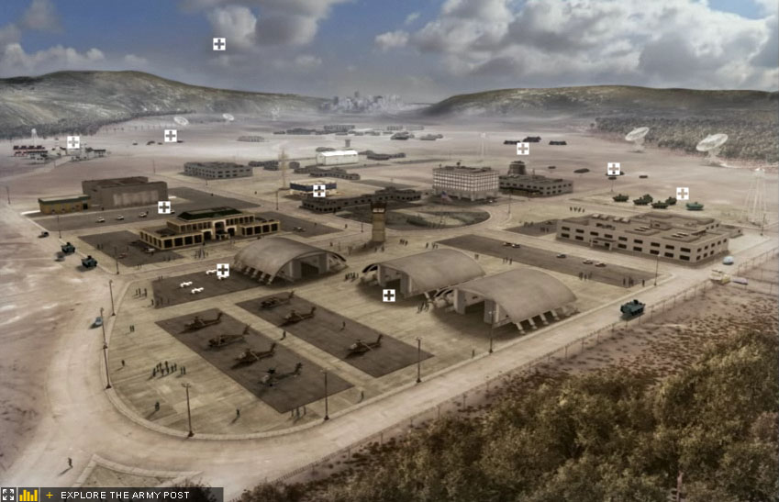


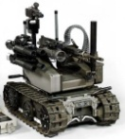






Program Summary Review: Operational Concept description
JIPS OV-1
GIG
SWORDS UGV
SWORDS UGV
C2 Station
SWORDS UGV
ENGAGE
Stronghold Sensor Suite
4
Notes:
This OV-1 for JIPS shows a notional use case scenario. The JIPs shall protect permanent and semi-permanent bases in Southwest Asia from conventional and asymmetric ground attack. The C2 station will communicate with the Stronghold Sensor Suite to detect possible threats or attacks around the perimeter of the base. The command will determine if the threat is real and needs to be addressed based on all available information (including intel from the GIG). The SWORDS (or MAARS) UGV system will then be remotely controlled to engage and neutralize the threat. Through the use of integrating stationary sensors and UGVs, the command will have exceptional situational awareness and ability to respond to threats.

Slide 5
Design Methods for External/Internal Interfaces
xx
5

Slide 6
Test and Evaluation Strategies to Reduce Technical Risk
5
4 |  | 2,3 |  | 4
3
2 |  |  |  |  | 1
1
 | 1 | 2 | 3 | 4 | 5
Risks
1: Schedule (Medium)
2: Integration (Medium)
3: Funding (Medium)
4: Joint Communications (High)
Impact
Integration and Joint Communications both have associated technical risk!!
Probability
High Risk
Medium Risk
Low Risk
6
Notes:
Based on the risk assessment discussed during IPR 1, 4 risk areas were identified in relation to the JIPS program. Integration and Joint Communications are the two areas considered to have the most technical risk requiring test and evaluation as part of their risk mitigation strategy.
Because these are COTS systems developed by different contractors in different countries, there may be some integration issues. To mitigate this risk, there needs to be tight coordination and multiple reviews to ensure that interfaces and information flow prior to testing. Data should also be collected from previous tests and demonstrations performed by ARL, TARDEC, and DARPA.
Facilitating joint communications was assessed as having high risk due to technical complexity associated with data interchange between two unique systems. Joint communications risk will be mitigated by utilizing compatible sensor suites and designing universal interface mechanisms.

Slide 7
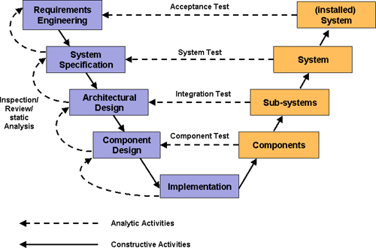
Test and Evaluation Strategies to Reduce Technical Risk
Multiple layers of testing will be performed to reduce risk and ensure successful system development.
Notes:
Test and Evaluation will also be used to reduce technical risk of the integration and joint communications of Stronghold and SWORDS. Testing will occur throughout the lifetime of the JIPS program and will include the expertise and input from critical stakeholders such as acquisition and development partners.
Prior to test and evaluation activities, modeling and simulation will be used to predict the likelihood of successful integration and to identify potential system interoperability issues.
Component level testing will be performed as necessary to verify the feasibility and proper operation of required sub-systems/components. In some cases, laboratory testing will be utilized as an initial test environment before testing in the field.
As system components mature, full-scale integrated system testing will be performed against the established metrics. Additionally, a sample of end-users will be used to verify usability, human factors integration (HMI), and training requirements. Feedback from end-users will be incorporated into the system design.

Slide 8
Design of Production and Support Systems
xx
8

Slide 9
Low-Rate Initial Production (LRIP) Description
xx
9

Slide 10
Production Levels vs. Deployment Schedule
10

Slide 11
Support Infrastructure vs. Deployment Schedule
11

Slide 12
Management of Obsolescence Issues
The system designer must consider the expected life of each component of the system relative to the life of the system.
If component life is less than system life then there should be a plan for component replacement.
The system plan should address obsolescence in design vs. leaving it to chance.
The length of the acquisition schedule plays a role in obsolescence particularly when choosing rapidly moving technology.
12

Slide 13
Training and Personnel Assignments to Support Manpower Requirements
Manpower requirements span both operation and maintenance and staffing quantity for both must be sufficient
Assignments align personnel to appropriate human factors in the system, both physical and psychological
Skill levels are determined for all human activities and form the basis for individual position requirements.
Resources are evaluated comparing current skill level against that needed. The difference forms the basis for training.
13
Notes:
“Operator personnel requirements are derived through the human factors analysis, particularly through the generation of the detailed operator task analysis and operational sequence diagrams. Maintenance personnel requirements evolve from the maintainability analysis, the supportability analysis and the detail maintenance task analysis.” (B&F, pg. 492)

Slide 14
Conclusion/Additional Concerns
xx
14

